Slide 1
Welcome to DevOpsDC!
6:30 - 7:00: Meet, greet, and eat!
7:00 - 7:15: Intros and Announcements
7:15 - 8:45: Presentations
Fearless Deployment – Ric Lister
Pipeline Game - Nancy Stetson
Everything is DevOps – Mark Cornick
8:45 - 9:00: Networking

Slide 2



Sponsors
Notes:
Excella – location
mHelpDesk - beer
Hobsons - drinks

Slide 3
Code of Conduct
http://www.meetup.com/DevOpsDC/pages/Code_of_Conduct/
We value the participation of each member of the community and want all attendees to have an enjoyable and fulfilling experience. Accordingly, all attendees are expected to show respect and courtesy to other attendees throughout all Meetup events.
To make clear what is expected, all delegates/attendees, speakers, exhibitors, organizers, and volunteers at any DevOpsDC event are required to conform to our Code of Conduct. Organizers will enforce this code throughout events.
Notes:
Conduct matters, so I’ll give you short, short version:
harassment-free experience for everyone, regardless of who you are
professional audience including people of many different backgrounds
Be kind to others. No smack talk

Slide 4
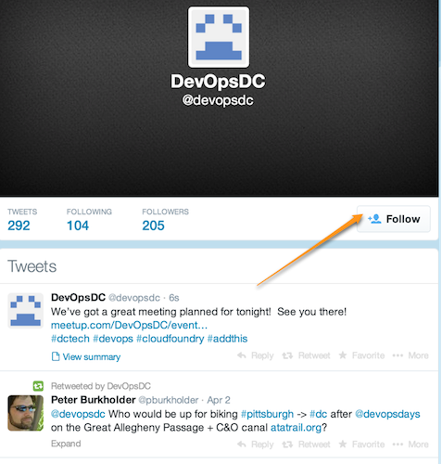
Do you even tweet?
https://twitter.com/devopsdc
Notes:
Twitter properly used is a boon

Slide 5

Slackin'…
http://www.dctechslack.com
http://slack.baltimoretech.org/
Notes:
Now let’s talk about some upcoming events….

Slide 6
Childcare
Contact Peter….
Notes:
Now let’s talk about some upcoming events….

Slide 7
Chef Training
Chef Essentials – March 6-7
Intermediate Topics – March 8-9
Discount code to save 10% - MEETUP
Early bird pricing until February 19
Notes:
Get your tickets 2 weeks in advance for early bird

Slide 8

DevOpsDays Baltimore
March 7 & 8, 2017
http://www.devopsdays.org/events/2017-baltimore/welcome/

Slide 9
Upcoming Meetups
February 21
Joint meetup with NOVA DevOps in Reston
March 14
Here in the ATX
https://github.com/devopsdc/devopsdc
Notes:
February is the third Tuesday because of Valentine’s Day. This is the first meeting of the NOVA DevOps group so we want to support and help them get started.
We have one speaker, DivvyCloud, already lined-up for March 14. There are a couple of other people in the pipeline, too. But if YOU want to present, send a PR to the github repo

Slide 10
Now it's your turn…
Hiring?
Looking for work?
Attending or speaking at a conference?
Something we all should know?
Favorite color?
Notes:
DoL Wage & Hour division: Senior Transformation Specialist, Product Manager, Software Engineer, and User Experience Designer
Last year, we put more than $246 million into the pockets of more than 240,000 workers who had been deprived of their hard-earned wages.
‣ For German Gomez, it meant finally being able to start a family after he received more than $42,000 in unpaid wages and damages following an investigation that disclosed he had been working 72 hours a week
‣ For Raquel Bruno, it meant being able to finish her degree and help her kids go to school,after the restaurant she worked for was found to owe more than $1 million to its workers.

